Slide 1
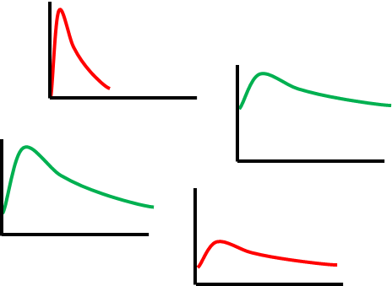
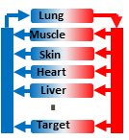


mTPA overview
Target Pharmacology assessment
Mode 0 Analysis: Best case scenario. For simple model shown here what would be impact of constant 100 % inhibition of protein P on clinical outcome A of interest.
Mode 2 Analysis: Conduct virtual PK & PD experiments
Start with PD model
B
Predict PK profiles
Cells, Tissues, Proteins or Biomolecules
A
Quick target quality assessment
Help indentify knowledge gaps
Drug inhibits formation
Clinical outcome of interest
k_{in}
P
k_{out}
logP
CL_{int}
pKa
fup
Formation
Degradation
Mode 1 Analysis: Stimulate PD model with pulses of target engagement with
varying magnitudes and durations
Cells, Tissues, Proteins or Biomolecules
BP
solubility
permeability
mechanistic pharmacodynamic model with “sufficient details” to simulate clinical outcome of interest whenever possible.
virtual combinations of compound properties to probe the response of the PBPK/PD model

Slide 2
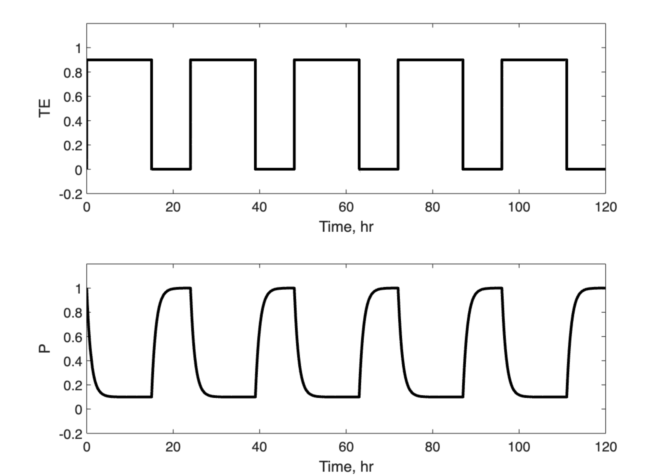
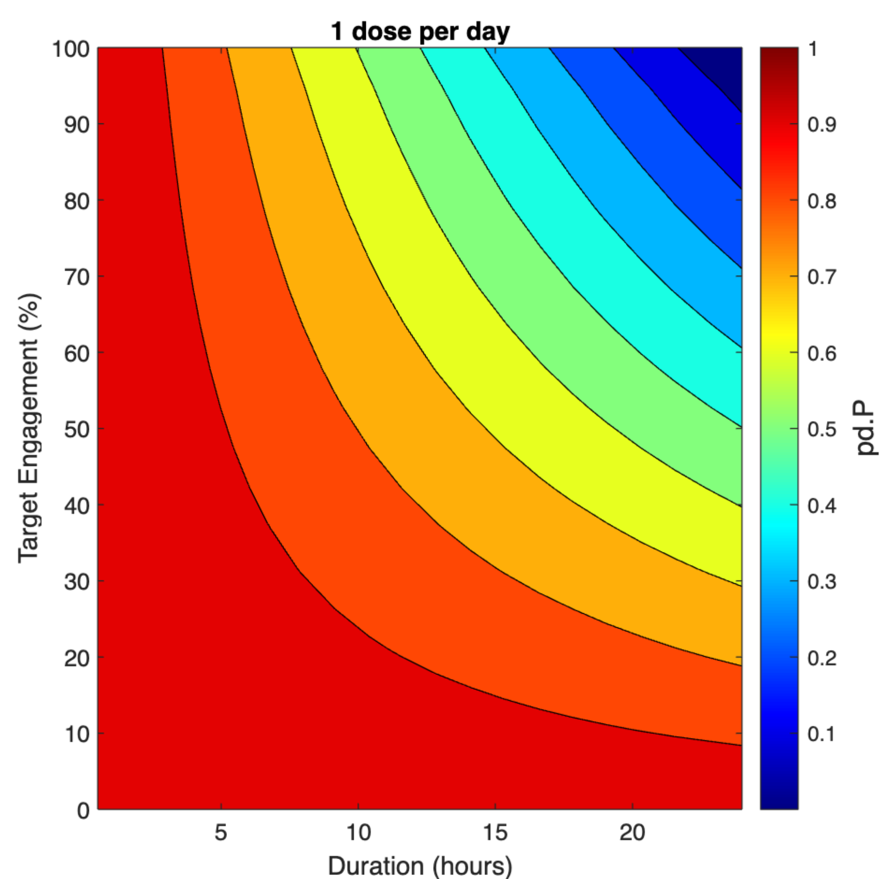
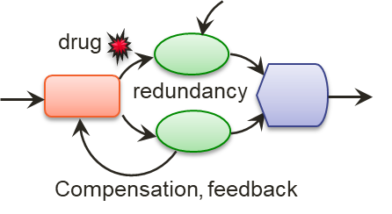
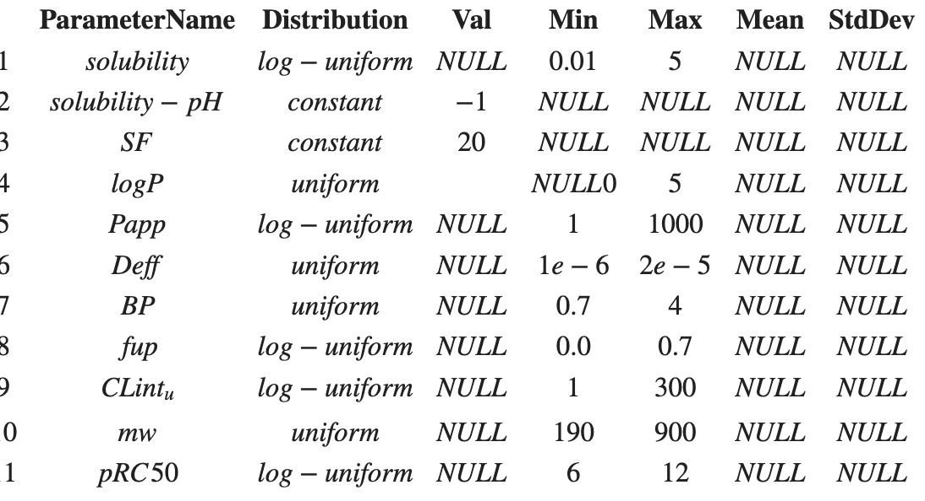
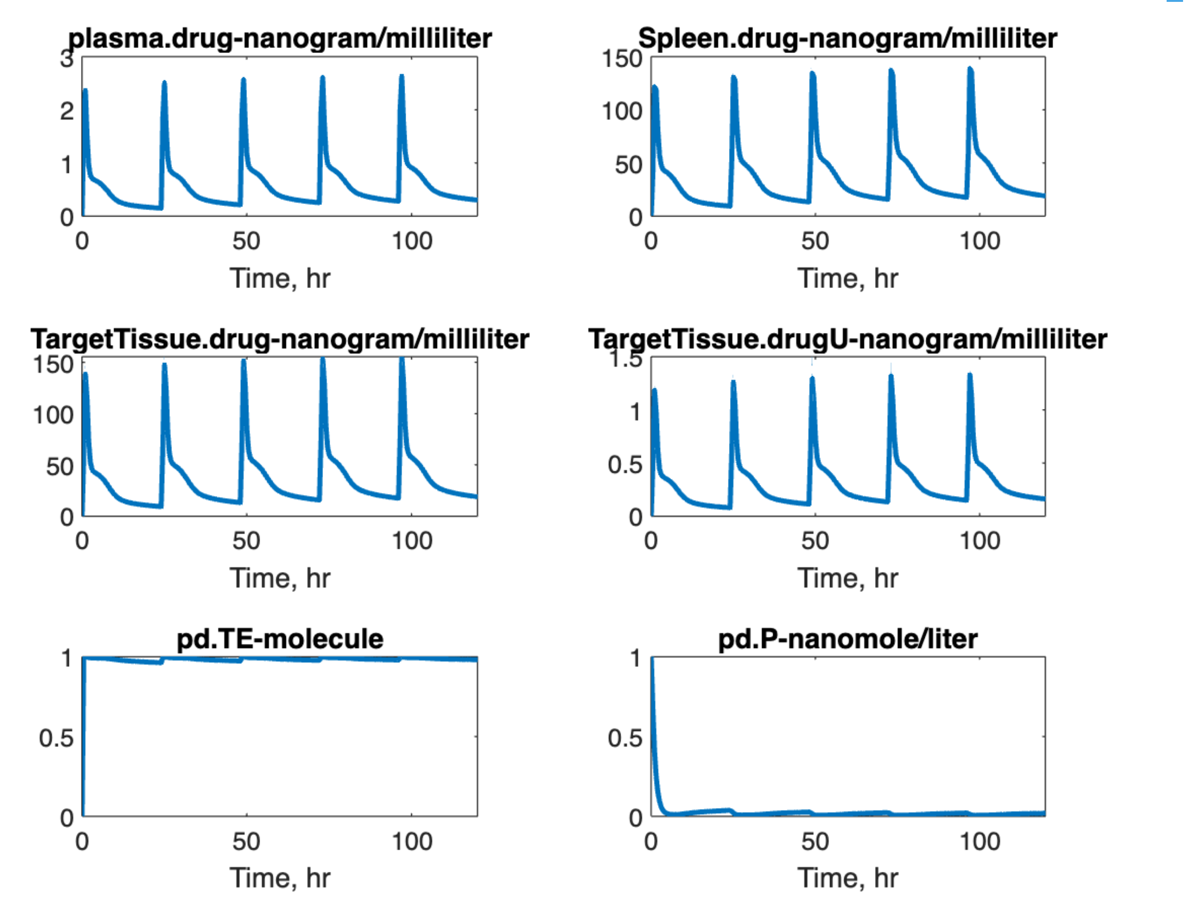
Overview workflow
Examine target level changes upon probing with one of the pulses
Create PD model
Integrate PBPK/PK with PD
Generate Virtual compounds to probe integrated PBPK-PD model
Target Engagement Duration scan
Verify model
Check units
Add requirements like including TE species, cl_TE parameter etc. to leverage TPA scripts from tooolbox
Probe PD model using step pulses to examine the effects
STEP 1
STEP 2
STEP 3
STEP 4
Test effects of large number of virtual compounds on outputs of interest
Processing results
Contour plots
Sensitivity analysis
Decision trees etc.
Examine effect of few virtual drugs for debugging and understanding
STEP 5
STEP 6
STEP 7

